Slide 1

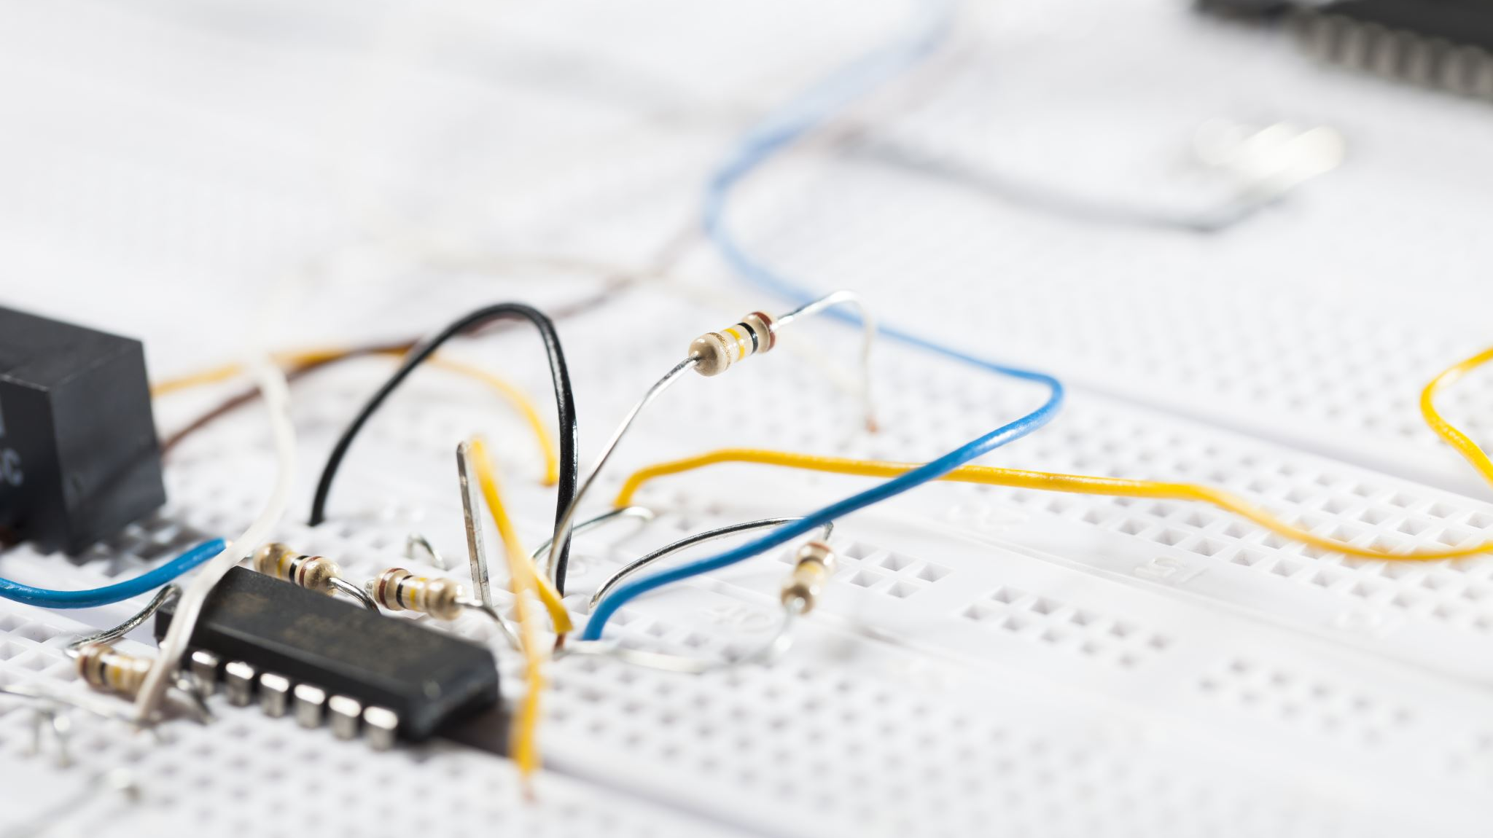
Soldering Station
Robbe Theunissen

Slide 2

Index
Introduction
Index
Process Flowchart
Main Characteristics
Key Features
Case Design
PCB Design
Discussion
Notes:
Will cover
Will touch on
At the end
Here i will cover some of the diffeculities i encountered during the coarse of this project

Slide 3
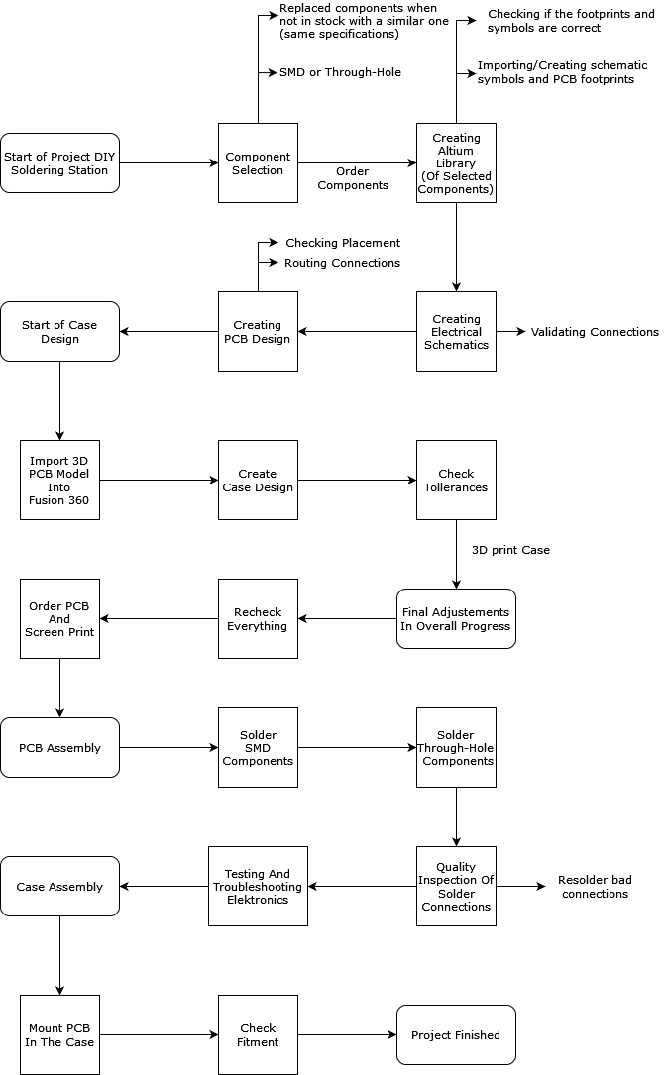




Process Flowchart

Slide 6
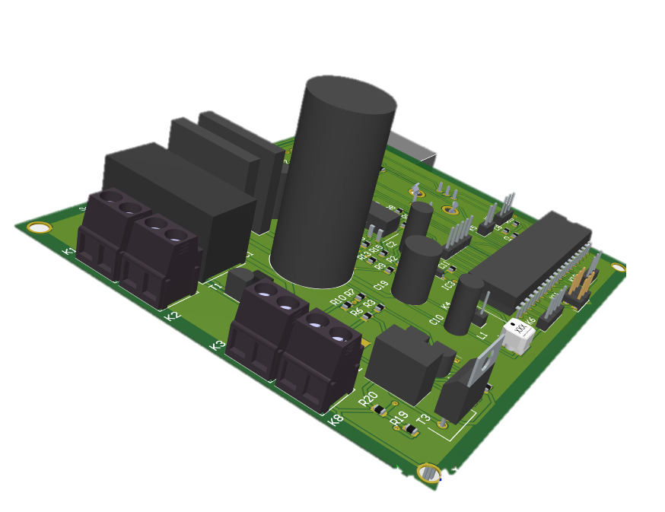
Main Characteristics
Fully capable driver
2x Full bridge rectifiers
2 x 12 V, 60 VA Transformer
ATmega-4809
SMD Technology
Notes:
The soldering station is a fully capable driver. It has all the basic features and more, I’ll come back to this in the next slide. In order to both support 12V and 24V soldering irons, I used 2 full bridge rectifiers in combination with a 2 times 12V transformer. The AT-mega microcontroller is responsible for controlling the temperature and driving the electronics behind it. I chose to use SMD components to keep the PCB as compact as possible.

Slide 7
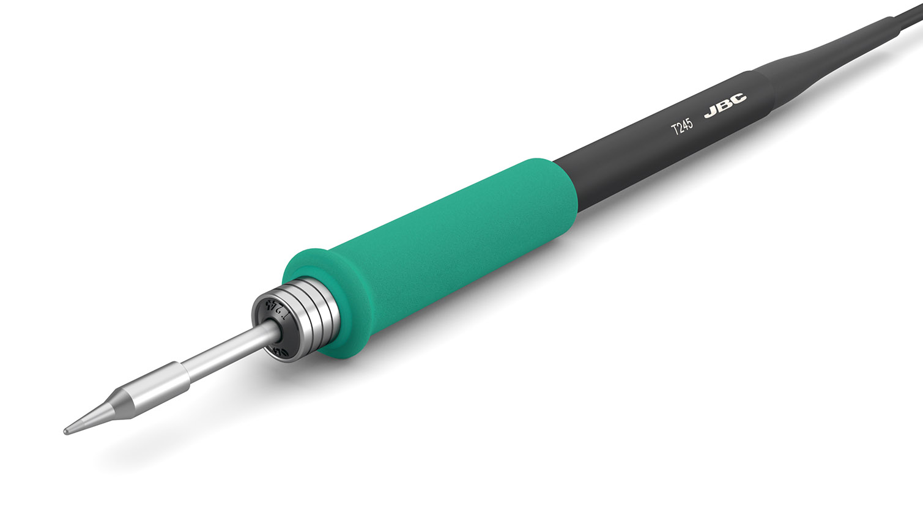
Key Features
Supports 12V/24V soldering irons
Error reporting
Temperature control
Both K & C-type temp. Probes
Fused Transformer
Easy to use interface
Open-source software
JBC T245
Notes:
Like I mentioned earlier both 12V and 24V soldering irons are supported. I’m going with the JBC T245 24V soldering iron. This iron is excellent for SMD components and in high power requirements. The temperature of the tip can be controlled with a rotary encoder on the front of the device. The dual opamp setup allows for both k and c type temperature probes. A fused transformer protects the users from shorts. The interface of the device is very easy to use and runs on open-source software.

Slide 8
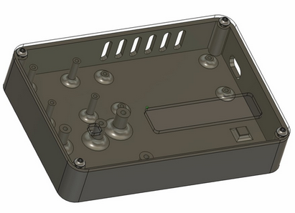
Case Design
Notes:
The main focus during the design process of the case was: simplicity, size, portability and durability. I went through a few iterations of the design before finally settling on this one. The case itself is printed in PLA. As a result of the slow printing speed, a long queue formed which delayed the production of my case.

Slide 9
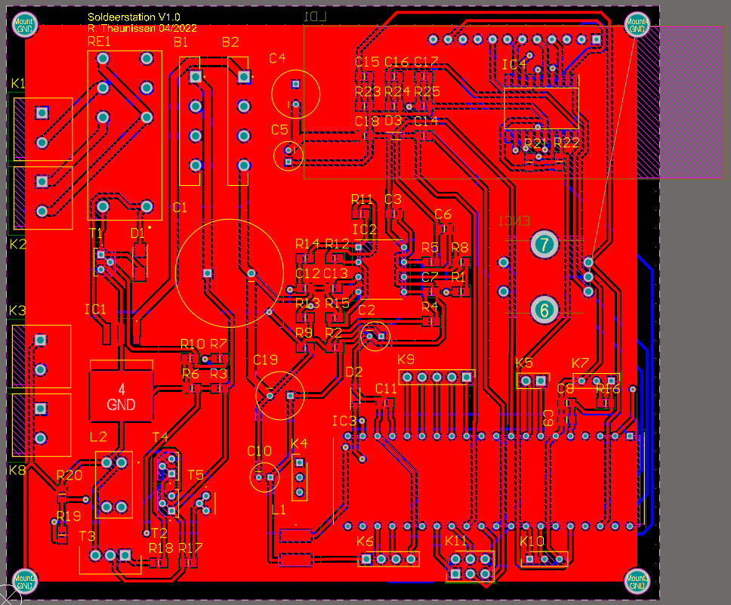
PCB Design

Slide 10
Discussion
Notes:
Some difficulities i encountered were
-The Scarecity of parts -> some components where swapped while still being similar in specification
-Full redesign of schematic symbols
This project allowed me to create a better understanding of the steps that need to be taken in order to make a working product. I took both the case- and PCB design as a challenge, in which I succeeded.
Thank you all for your attention, are there any questions?

